Slide 1
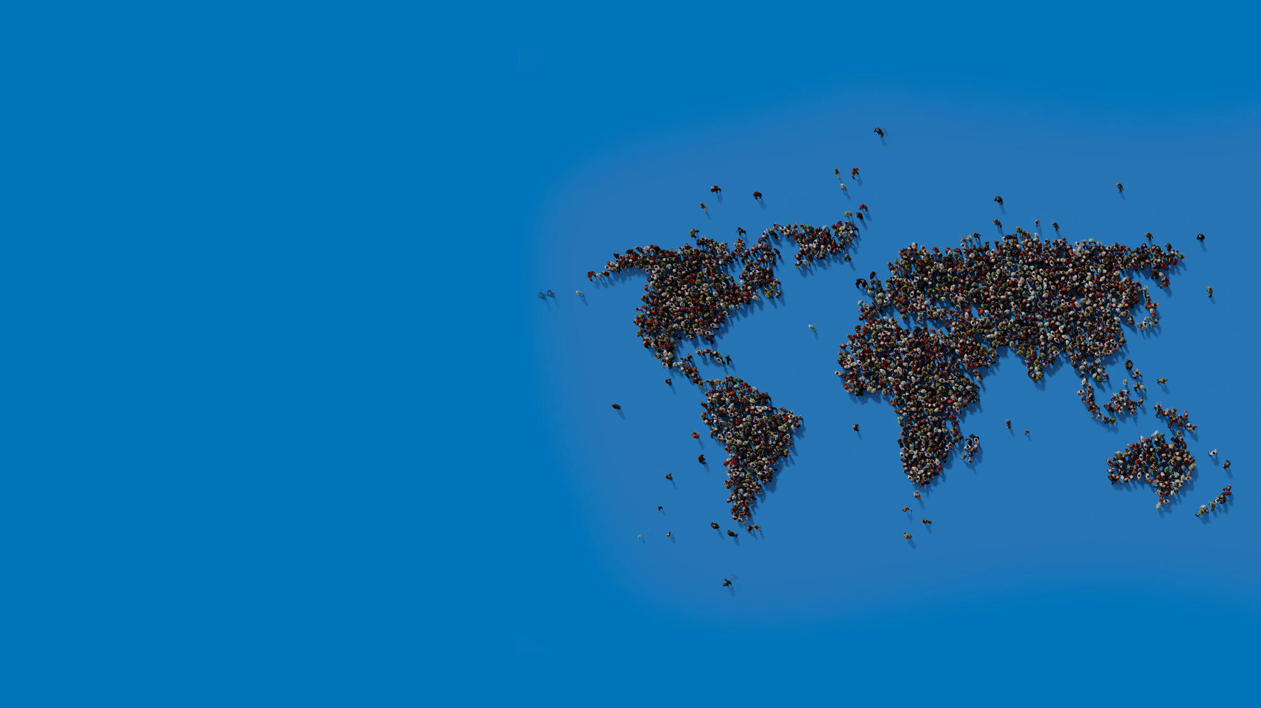

What is all this fuss about Python?
Dr. Charles Severance
University of Michigan School of Information
https://github.com/csev/talks
Ghandi quotes on education from: https://www.foradian.com/10-most-inspiring-views-of-gandhi-on-education/
Notes:
Alternate thank you page

Slide 2
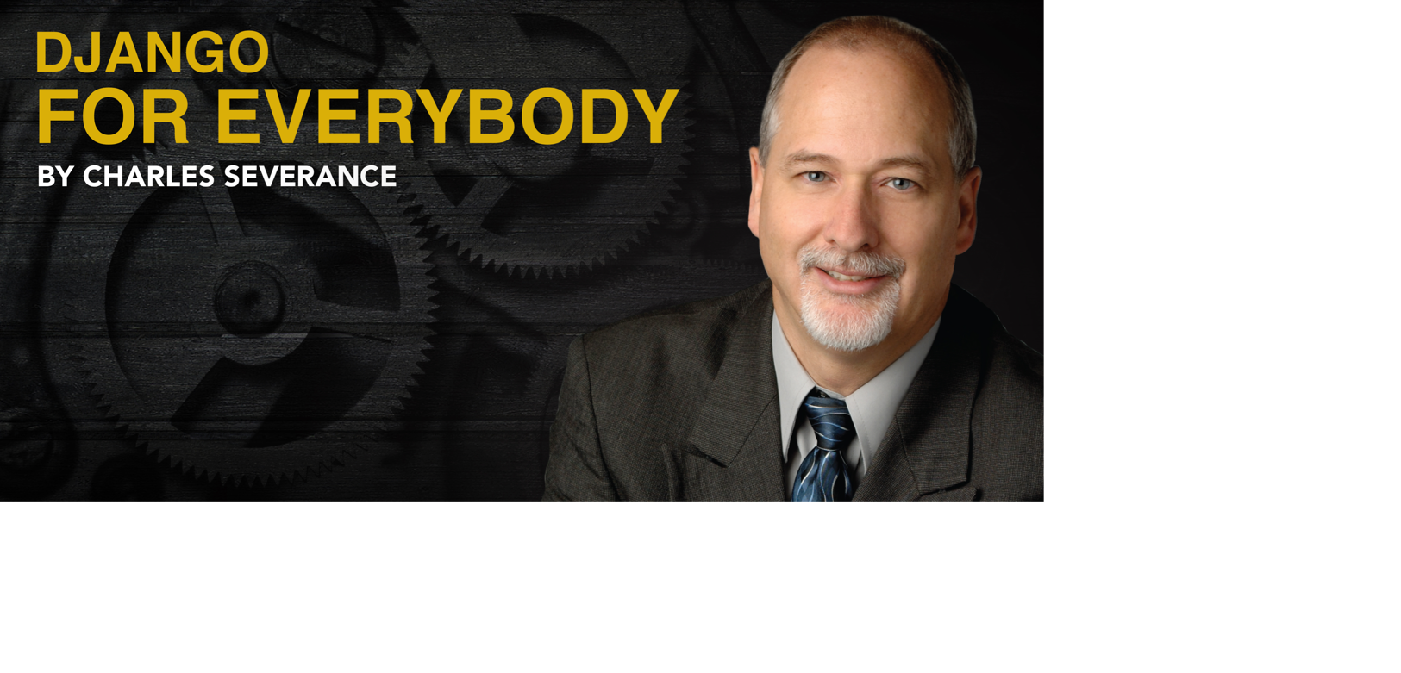

Slide 3
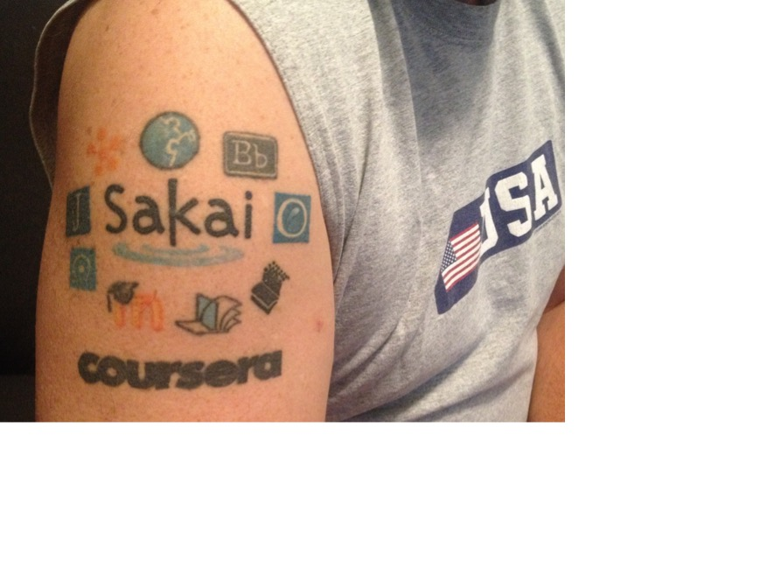
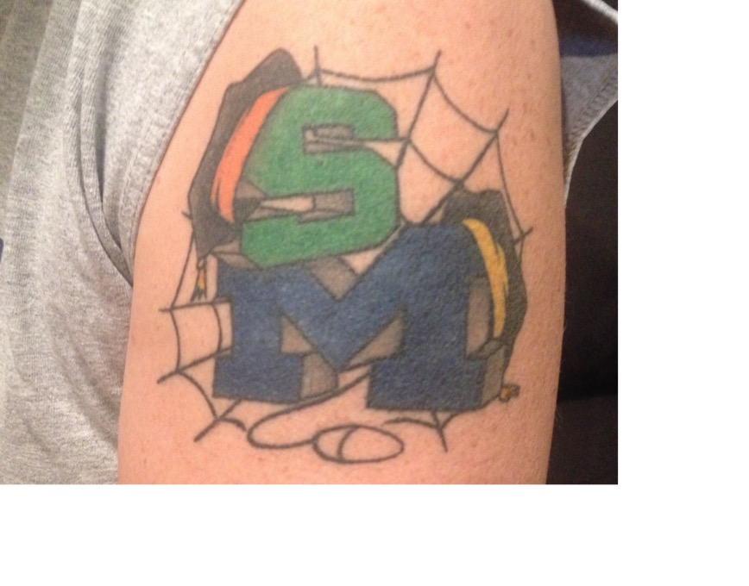
Python for Everybody: The Largest Programming Course in the World
Literacy in itself is no education. Literacy is not the end of education or even the beginning.

Slide 4
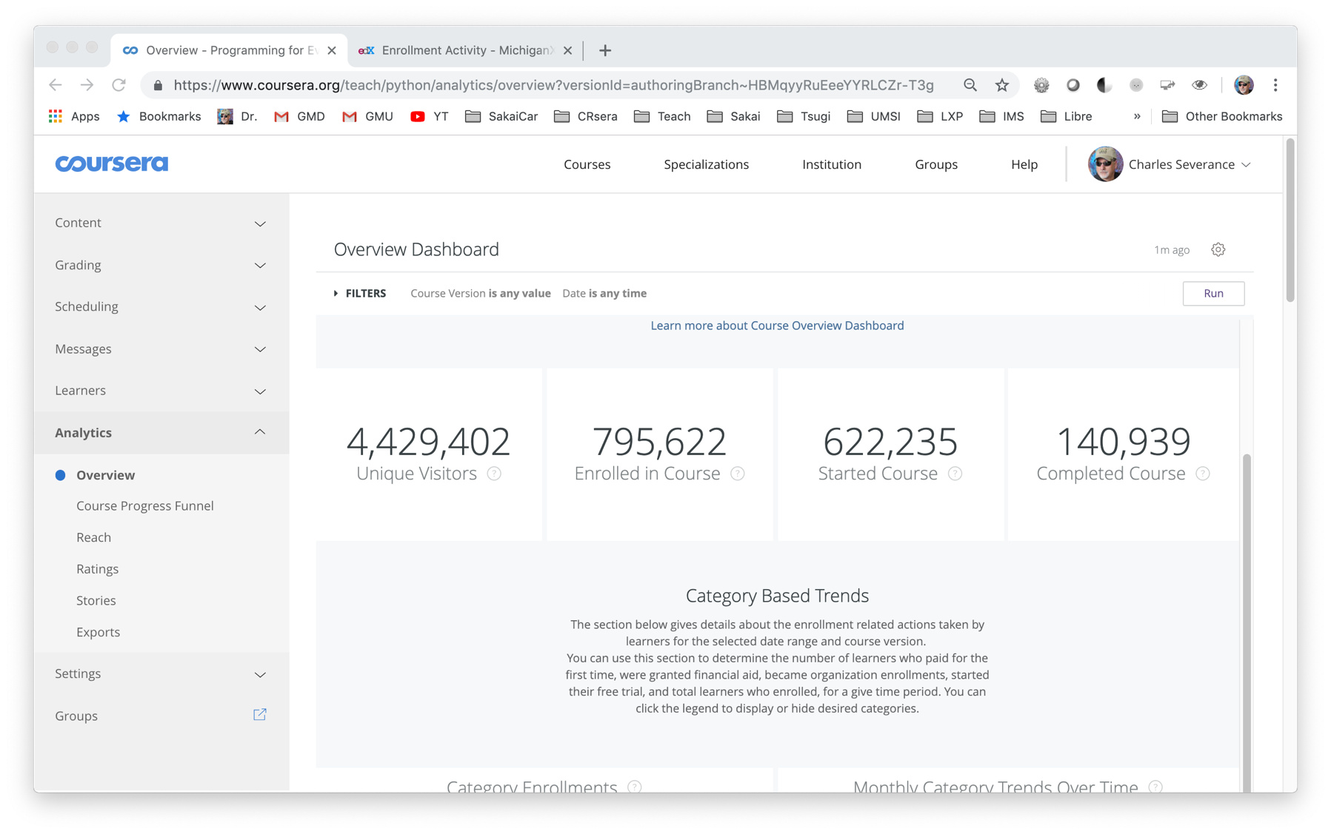

Slide 5
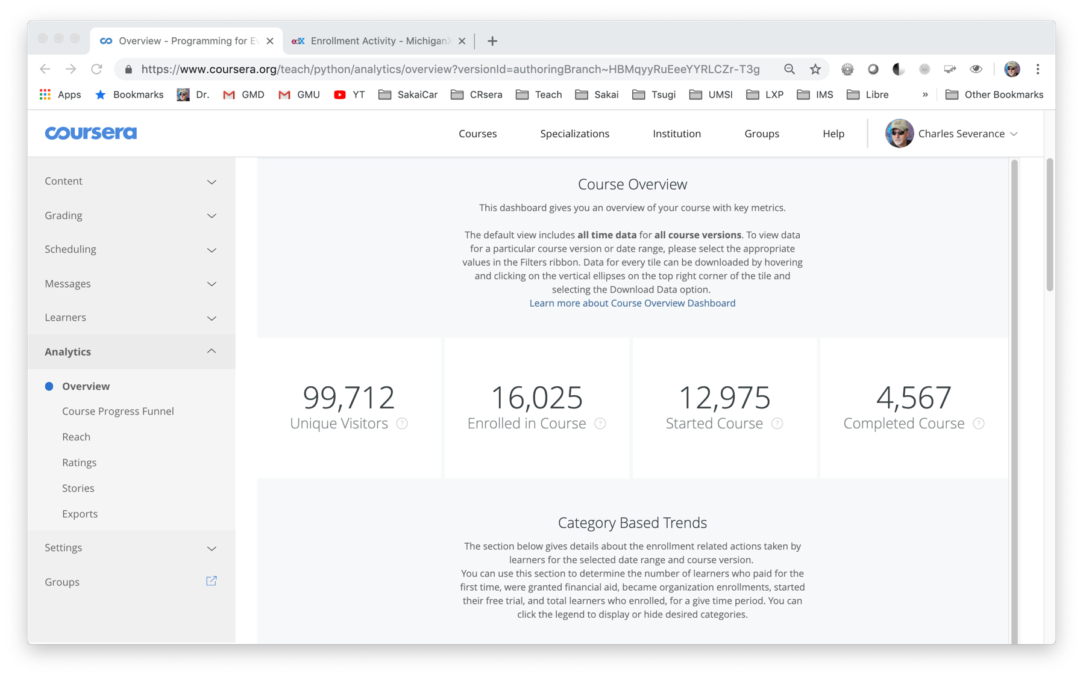
Last Month

Slide 6
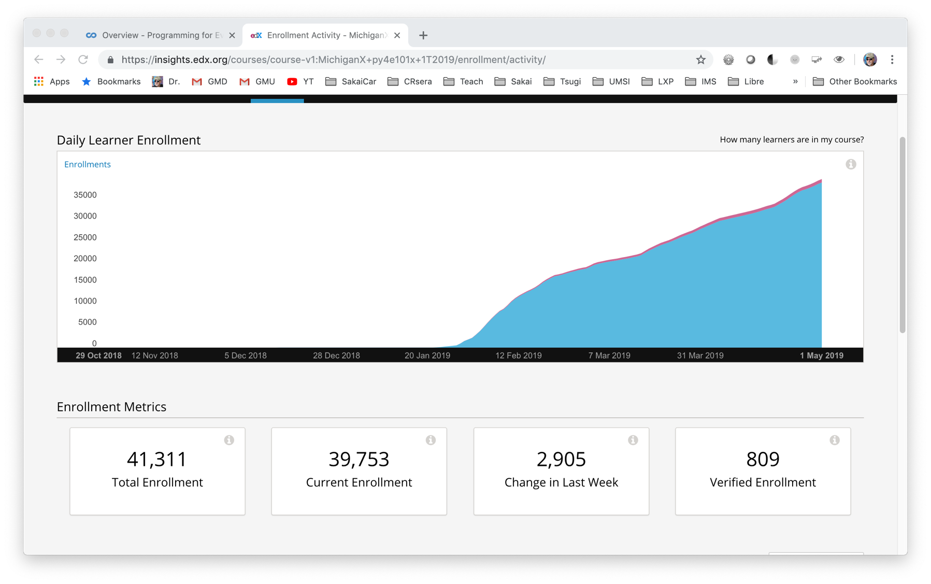
Last Three Months

Slide 7
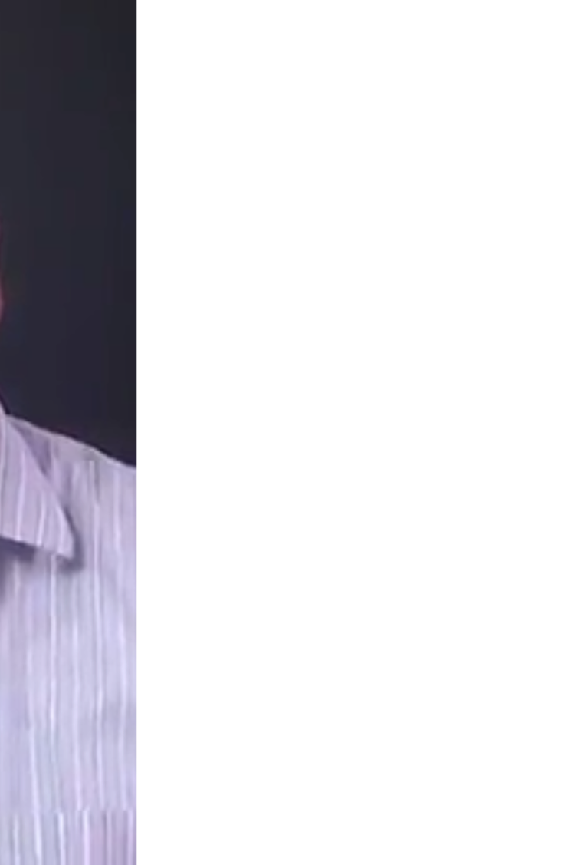
Goals for the Course
Anyone can program – no prior knowledge
Build skills in taking programming classes
Teach others to be a mentor / teacher
Kit of free and open materials (CC)
Videos / PowerPoints / Book / Software
Encourage translations, remix, and republish
Create a movement – programming for everybody

Slide 8
Learning is about people
A teacher who establishes rapport with the taught, becomes one with them, learns more from them than he teaches them.

Slide 9
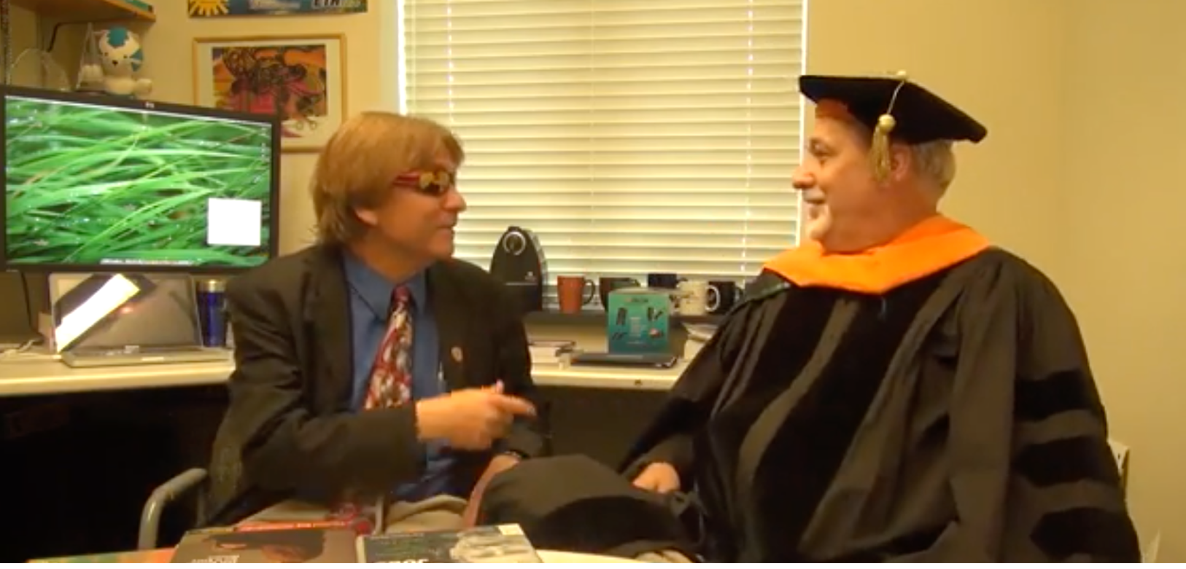
https://www.youtube.com/watch?v=SfQYA0JQWkA

Slide 10
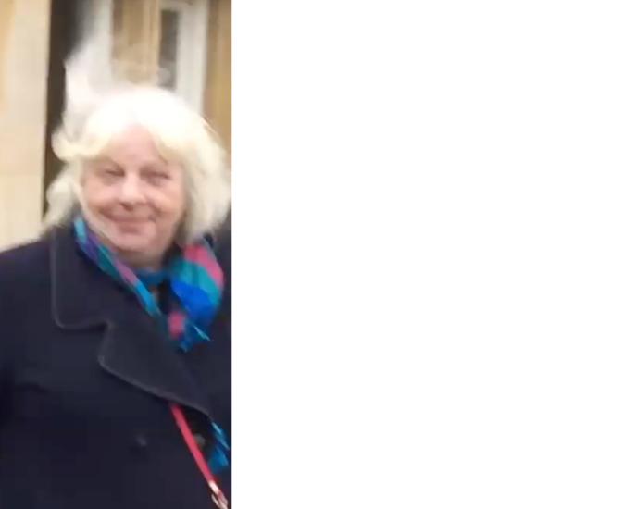
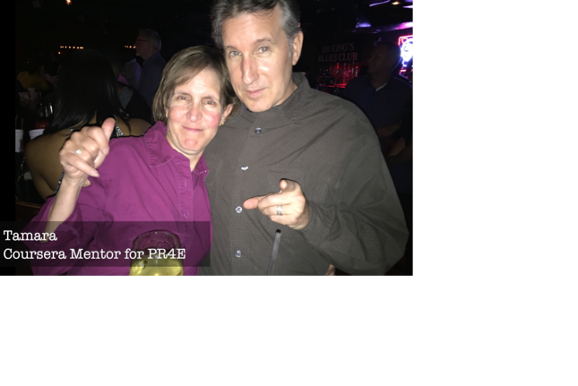
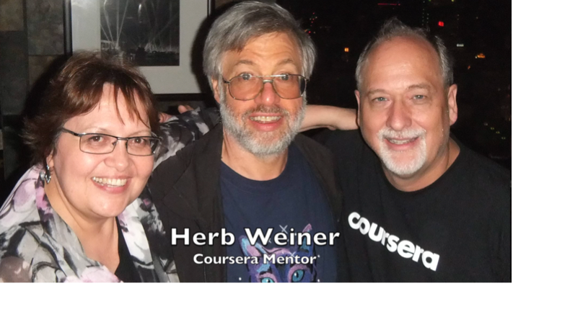
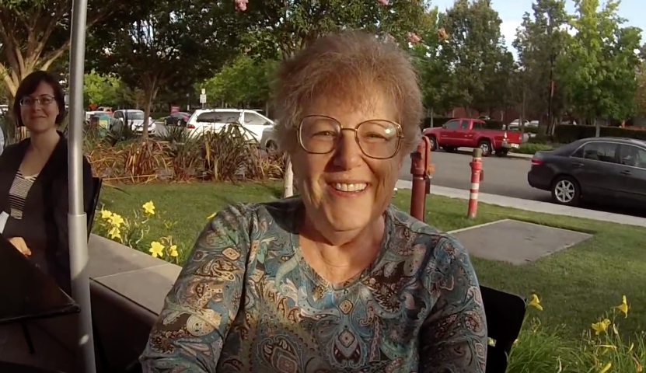
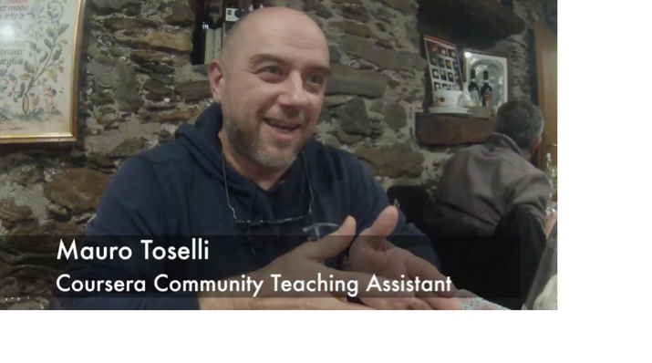

Slide 11
New York, Los Angeles, Ann Arbor, Chicago, Washington DC, Memphis, Seattle, Seoul, Barcelona, London, Mexico City, Amsterdam, Manila Melbourne, Perth...
https://www.dr-chuck.com/office
Notes:
Since I have a very active travel schedule, I decided to hold office hours in the major cities I have visited. I have held office hours in over 40cities and in each location somewhere between two and 15 students show up.

Slide 12
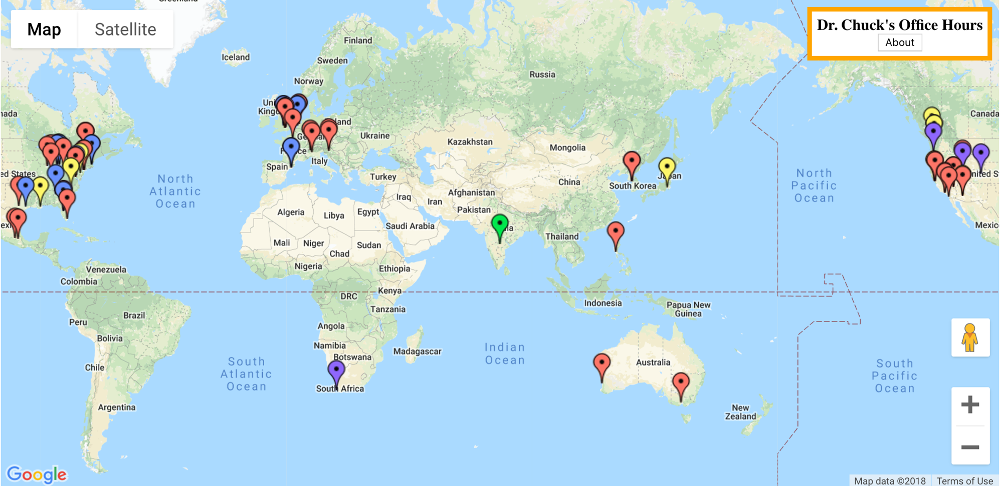
www.dr-chuck.com/office

Slide 13
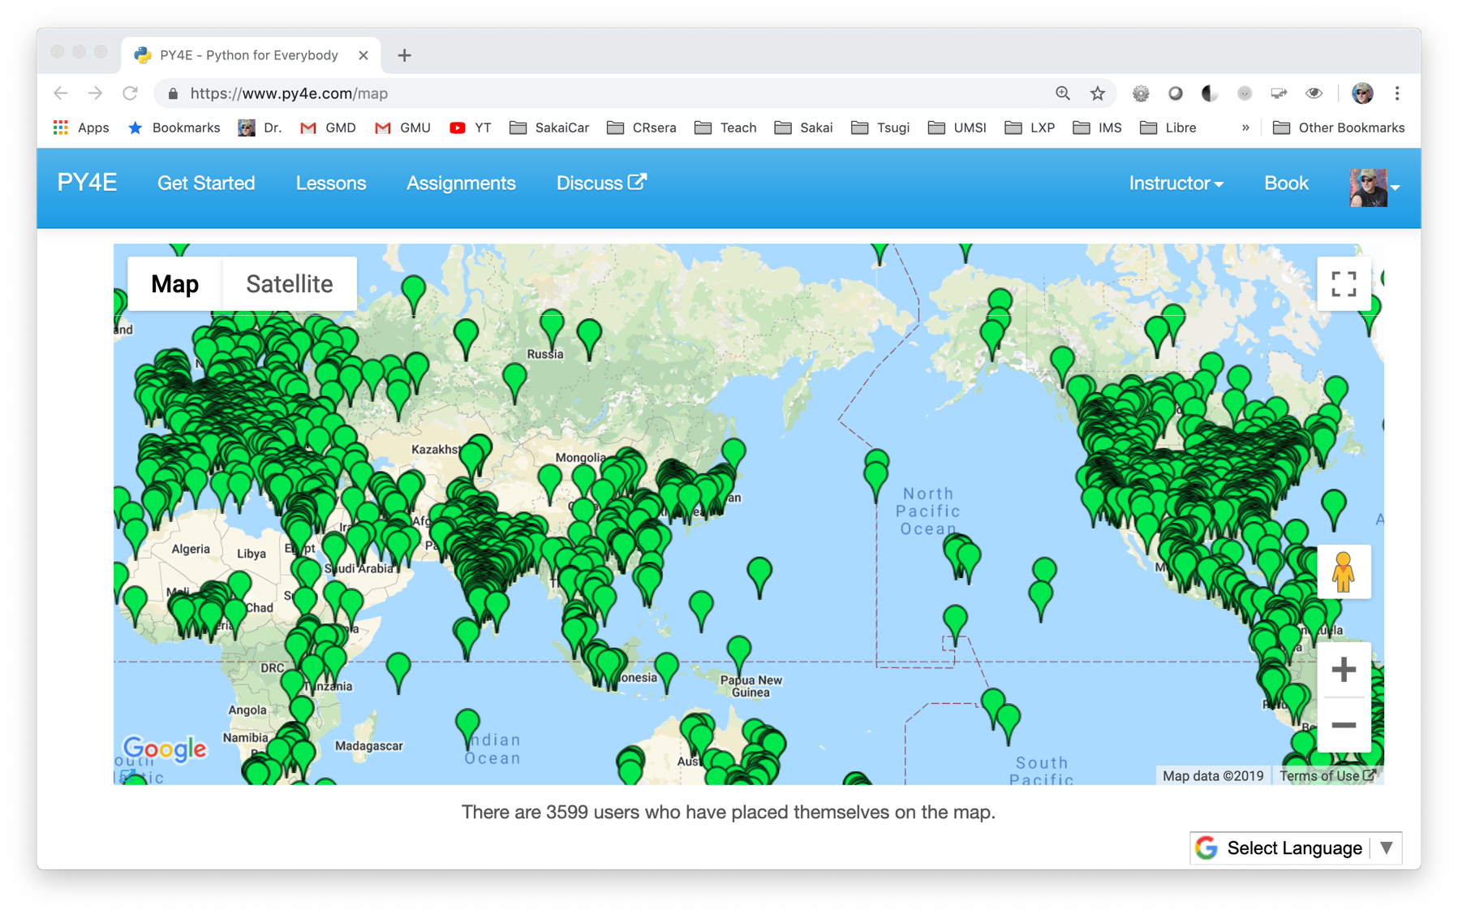

Slide 14
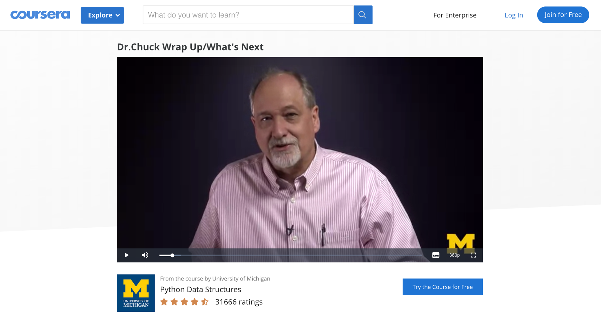
https://www.coursera.org/lecture/python-data/dr-chuck-wrap-up-whats-next-X9X5o

Slide 15
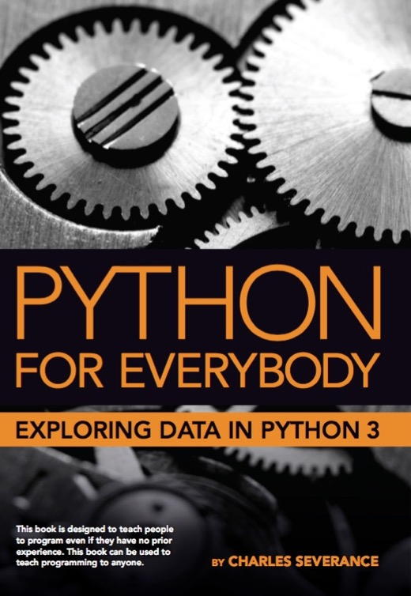
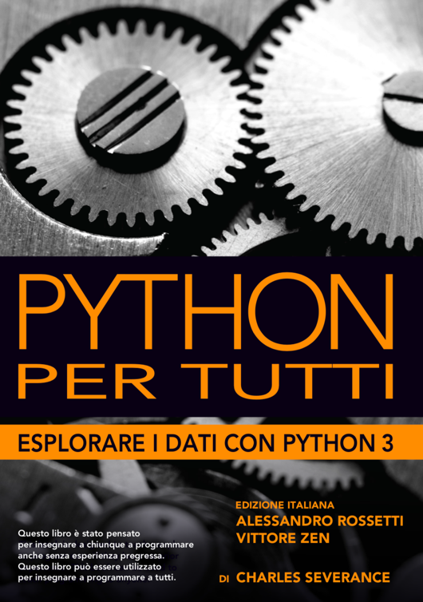
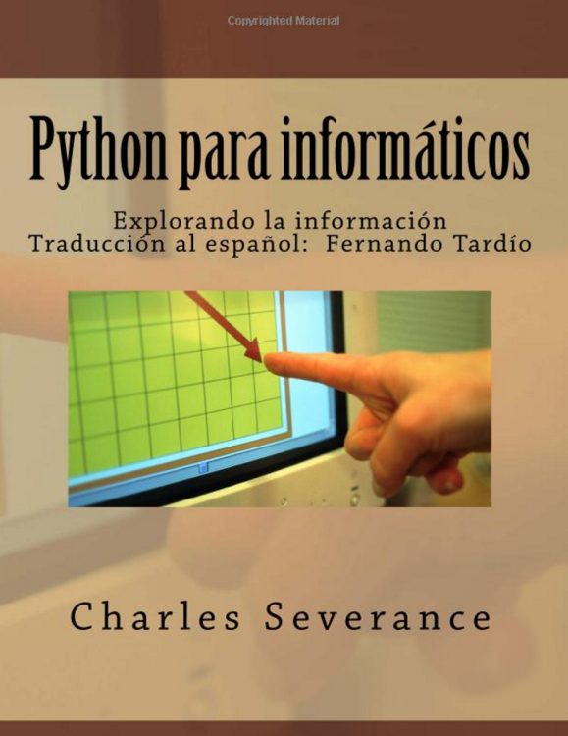
Adapted from: How to Think Like a Computer Scientist, by Alan Downey, Jeff Elkner
Chinese, Portuguese, and Korean
2008 - present

Slide 16
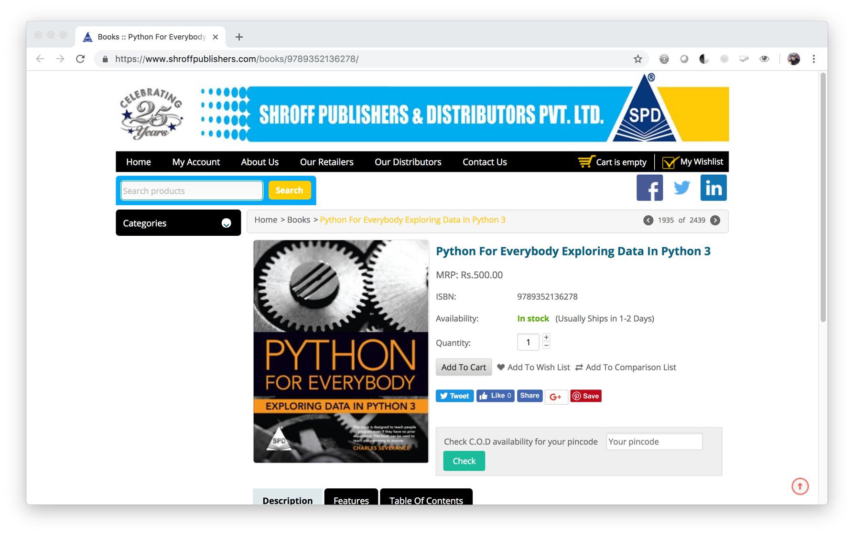

Slide 17
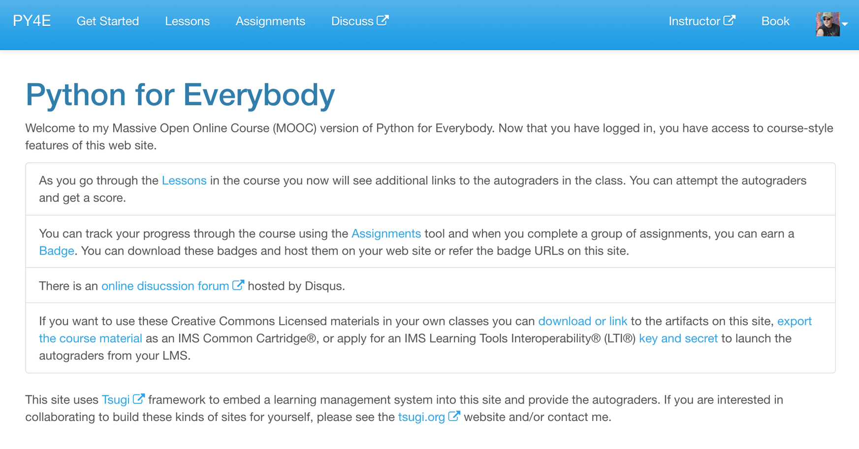

Slide 18
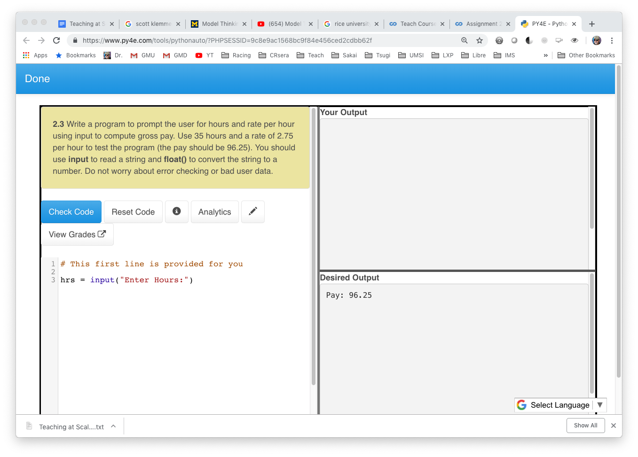
TEACHING AT SCALE | IIT TECHFEST 2018

Slide 19
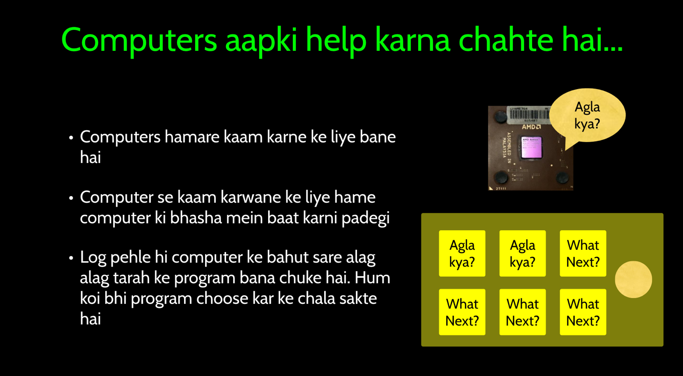
AR BG BN CS KA KO MS NL PL PT-br PT-pt RO RU SK SL SQ TE TR UA VI ZHE HI HR-Croatian HU IT

Slide 20
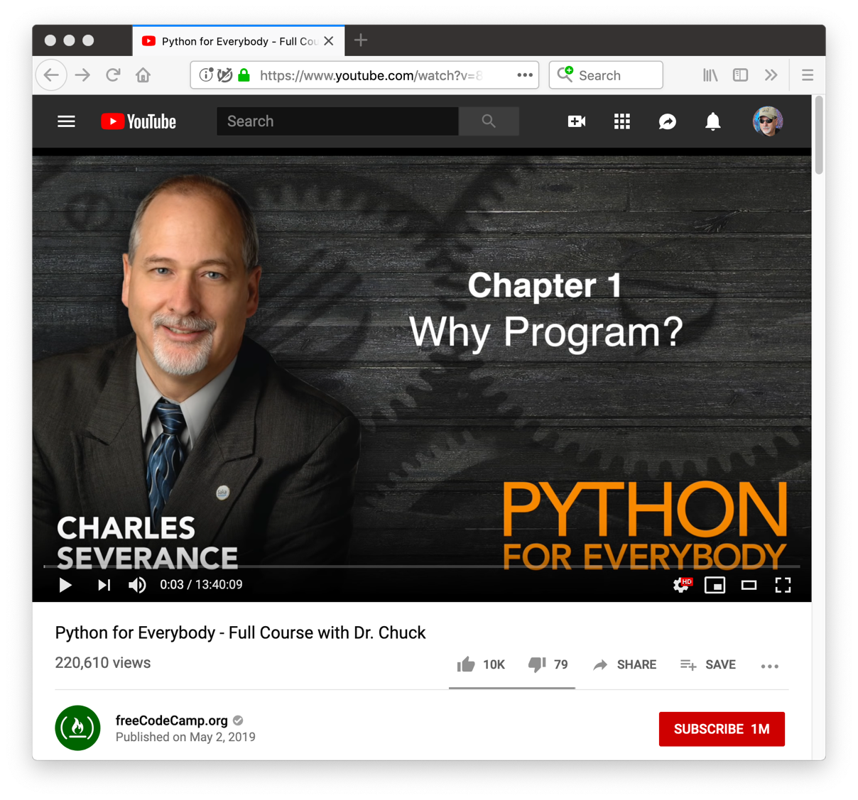

Slide 21
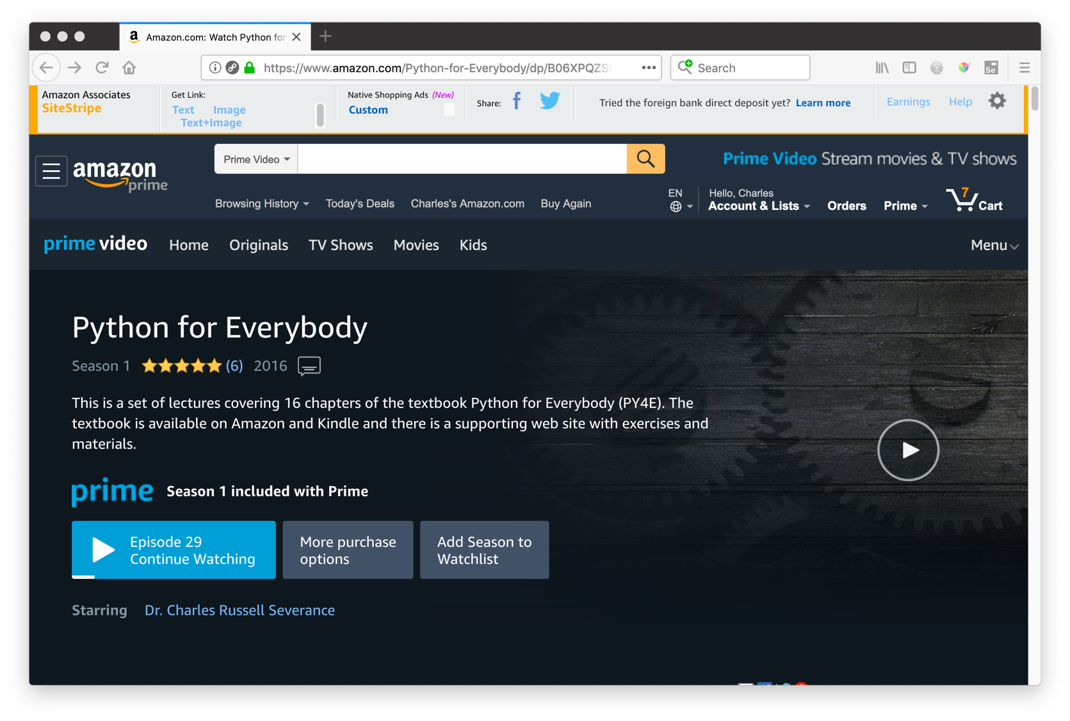

Slide 22
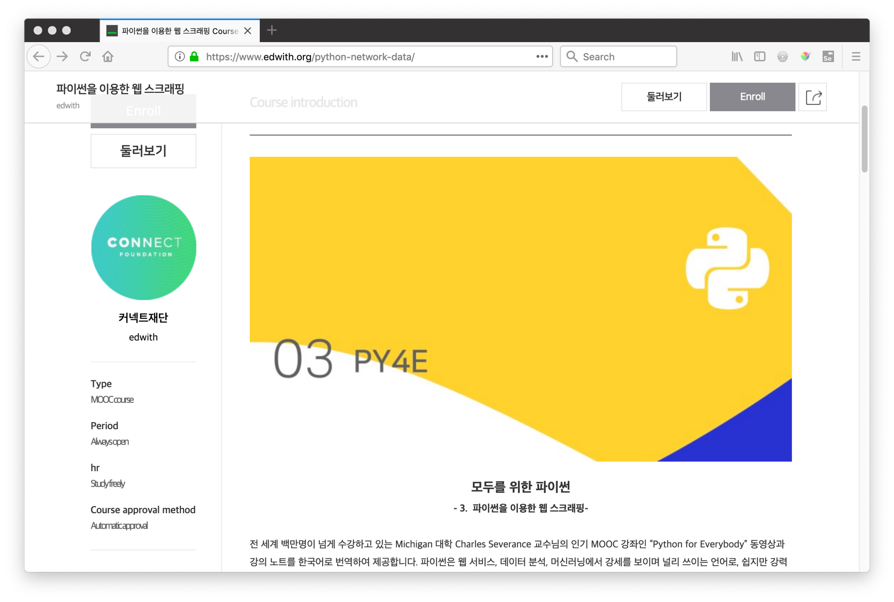

Slide 23
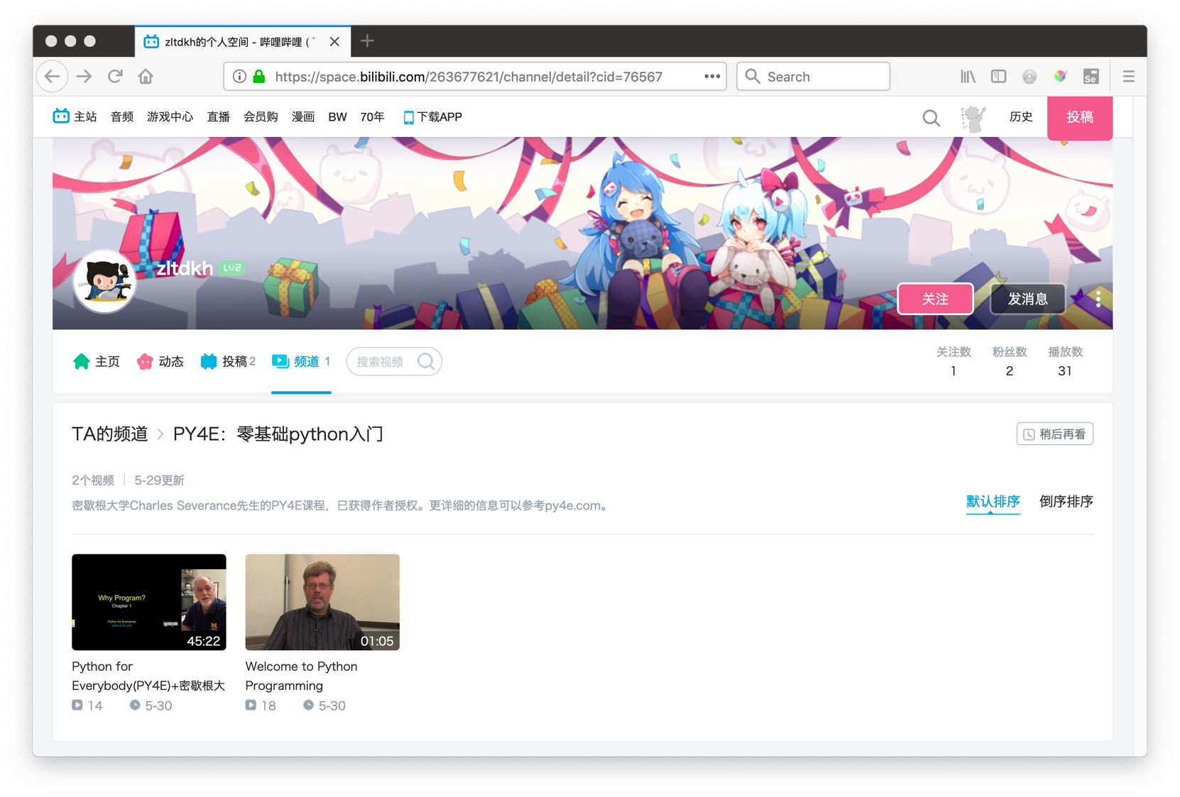

Slide 24
Liberal Arts Technology (LAT)
The goal for this effort is to develop a technology curriculum that can be easily added to the course catalog of a liberal arts school/college. Through a combination of course design, supporting material, a teacher community and teacher training - these course will be taught naturally be liberal arts faculty. These courses will not require the hiring of Computer Science Faculty or adjunct specialists. The learning will always be grounded in Liberal Arts Principles. This program is not intended as a replacement for a Computer Science curriculum, but can be used to better prepare students for more advanced computer science courses if the students are interested in those courses.
Throughout this program, the focus is on using free and openly licensed course materials to keep the cost of this program as low as possible for adopting institutions. The free and licensed materials will include books, quizzes, PowerPoint slides, automated grading software, and other supporting material to help teachers come up to speed quickly.

Slide 25
Programming Curriculum
CS1
APCS
Java
3 Cr (12)
HW4E (ch 1-10)
Circuits/Gates
1.5 Cr (11)
CC4E (ch 1-10)
C / Alg / Data St
3 Cr (11)
WD4E (Part 2)
Design / Accessibility
1.5 Cr (9/10)
DJ4E
Django/JS
3.0 Cr (10/11)
PY4E (Part 2)
Data Analysis
3 Cr (10/11)
WD4E (Part 1)
HTML/CSS
1.5 Cr (8/9)
PY4E (Part 1)
Programming
1.5 Cr (8/9)
Scratch/MindStorms/etc… 6/7/8

Slide 26
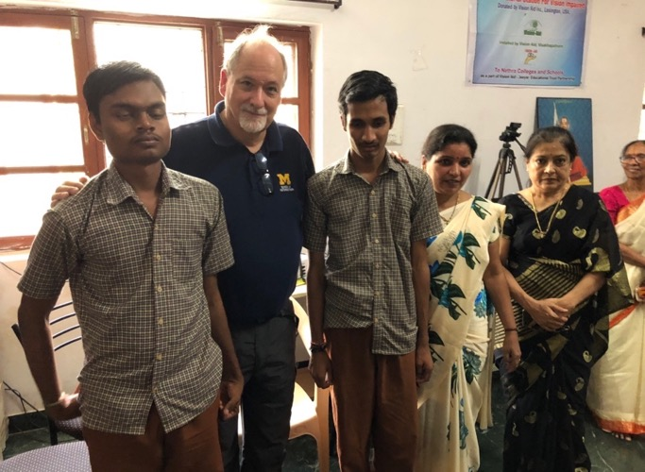
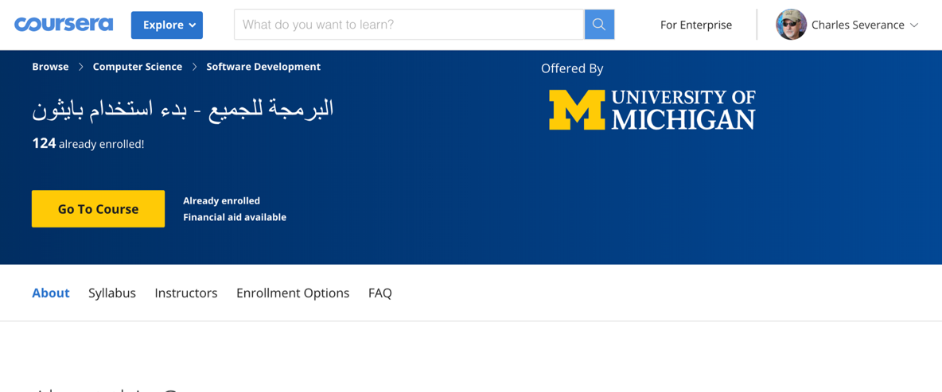
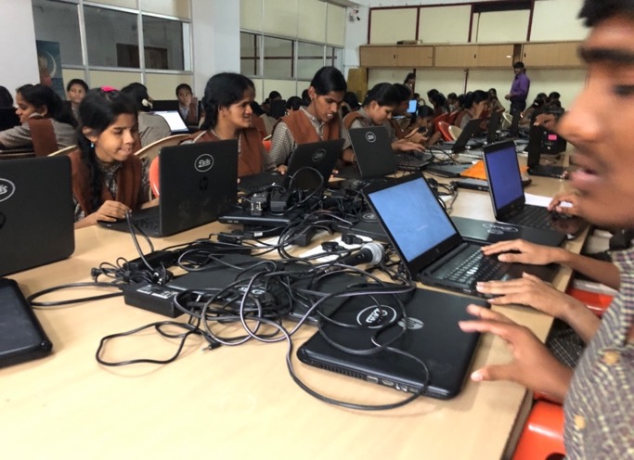
Python for Everybody - Everywhere

Slide 27
Python for Everybody: The Python Language
Literacy in itself is no education. Literacy is not the end of education or even the beginning.

Slide 28
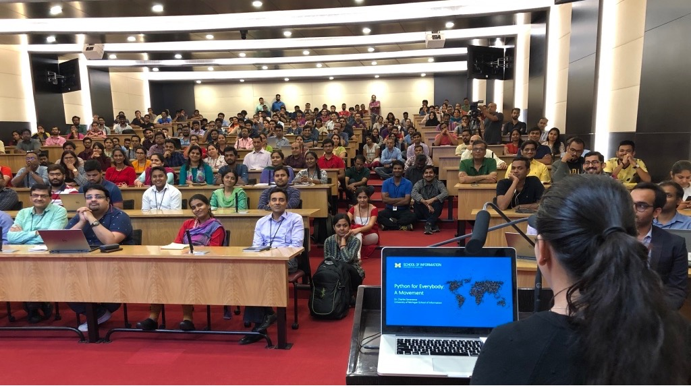

Slide 29
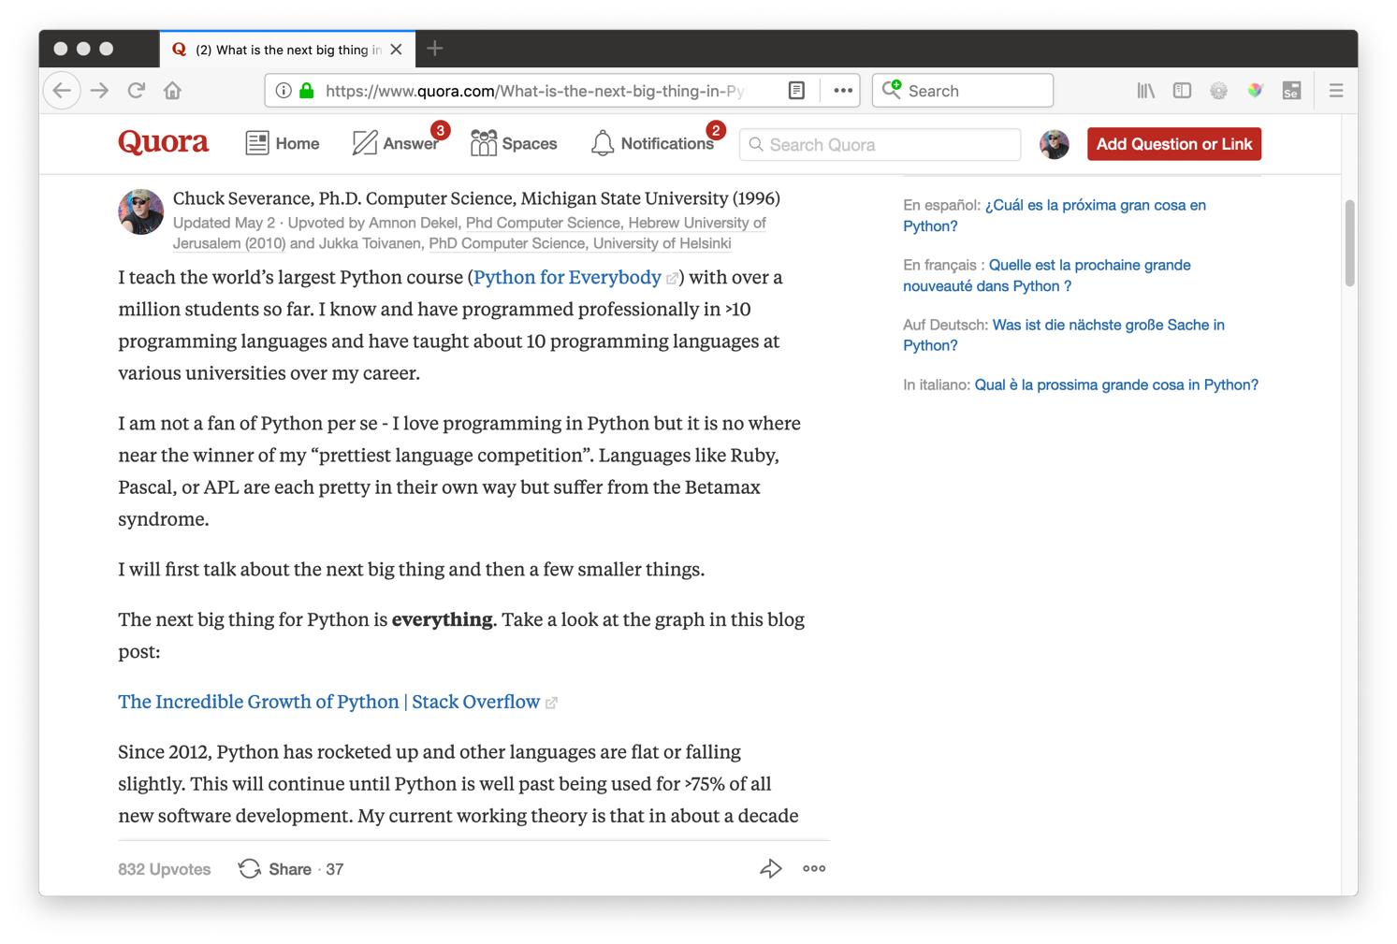
https://www.quora.com/What-is-the-next-big-thing-in-Python

Slide 30
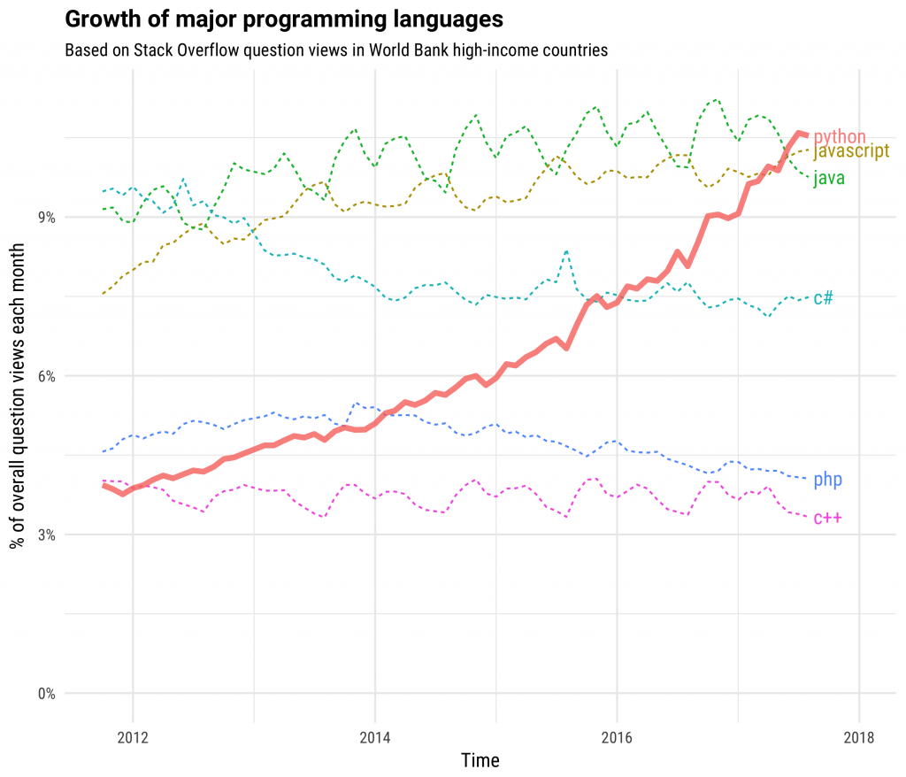

https://stackoverflow.blog/2017/09/06/incredible-growth-python/

Slide 31
Why Python?
The core of Python is small and easy to understand
Python is easily expanded using C when performance is critical
Python absorbs applications and turns them into libraries
Python loves orchestration
Statistics
Computation
AI / ML
Data Mining
Web Apps
????

Slide 32
Language Comparison
Language | Python | PHP | JavaScript | Java | C#
Linear | List / Tuple | Associative Array | Array | List<T> / Array | List<T>
Key / Value | Dictionary | Associative Array / Object | Object | Map<K,V> | Dictionary<TKey,TValue>
Packaging | Simple | Simple | Mishmash | Maven
Java int (primitive) versus Integer (object)
PHP – arrays are primitives
Ease of plugging in powerful "native" / C extensions to Python (PHP too)
Java / C# - data structure shape must be pre-agreed all the way down
….

Slide 33
Python 2 versus Python 3
There were a set of "features" that were seen as important for Python that would break Python 2 programs
Python 2 did not support Unicode well – relevant only in western cultures with Latin character sets
There won't be a Python 4 – It took 15+ years to figure out what was needed to make Python 3

Slide 34
Starting in 1975
Starting in 2015
APL
FORTRAN
CDC 6500 Assembly
Pascal
Basic
IBM 360 Assembly
Prolog
COBOL
Burroughs Med Sys
HP21MX Assembly
C
REXX
csh
HTML
Visual Basic 4
Real Basic
C++
ASP
SQL
bash
Java
Spring
Hibernate
JavaScript
CSS
JQuery
Ruby on Rails
PHP
Python
Django
HTML
CSS
JavaScript
Python
SQL
Django
Pandas
Numpy
React
VueJS
Swift
Java
VB.Net
iconic
asm.js
NLTK
SciPY
PyGame
C
TensorFlow

Slide 35
Starting in 1975
Starting in 2015
('Hello world'⍷'world')⍳1
pos = 'Hello world'.find('world')
pos := pos('world', 'Hello world');
var pos = "Hello world".indexOf("world");
int pos = strpos("Hello world", "world");
var pos = "Hello world".indexOf("world");
pos = InStr("Hello world","world")
int pos = :"Hello world".indexOf("world");
pos = "Hello world".find("world")
$pos = strpos("Hello world", "world");
pos = 'Hello world'.index('world')
https://en.wikipedia.org/wiki/Comparison_of_programming_languages_(string_functions)#Find

Slide 36
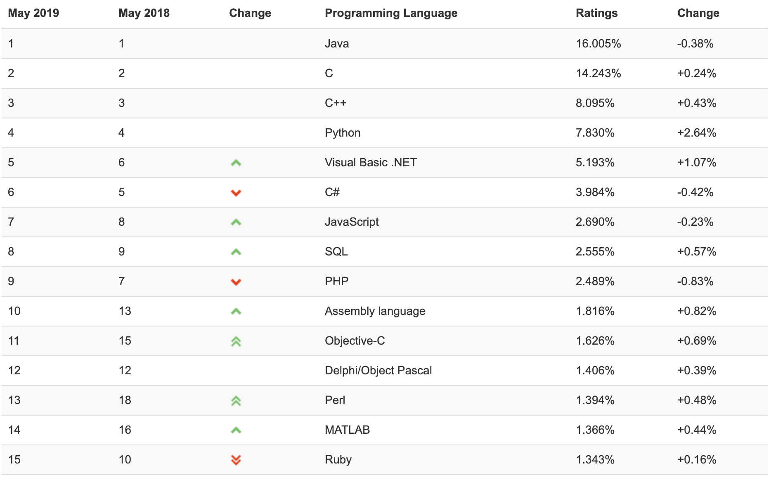
https://www.tiobe.com/tiobe-index/

Slide 37
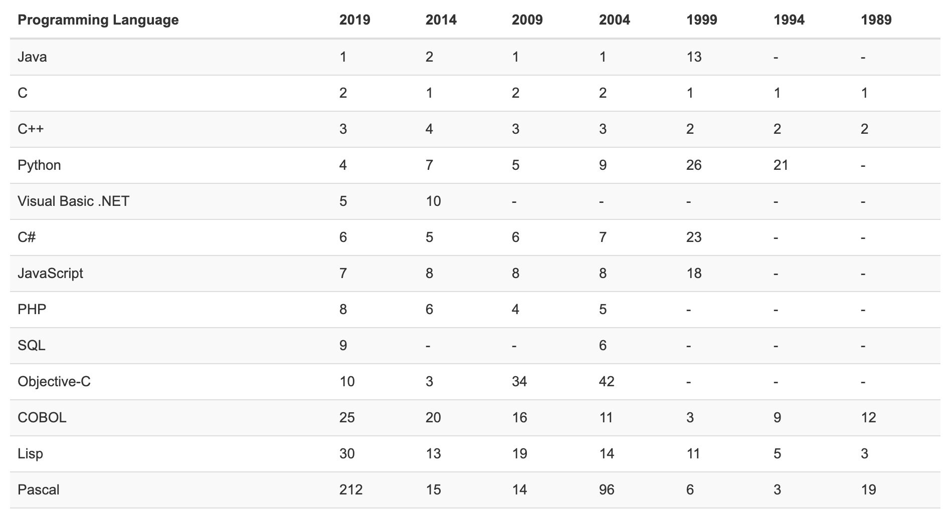
https://www.tiobe.com/tiobe-index/

Slide 38
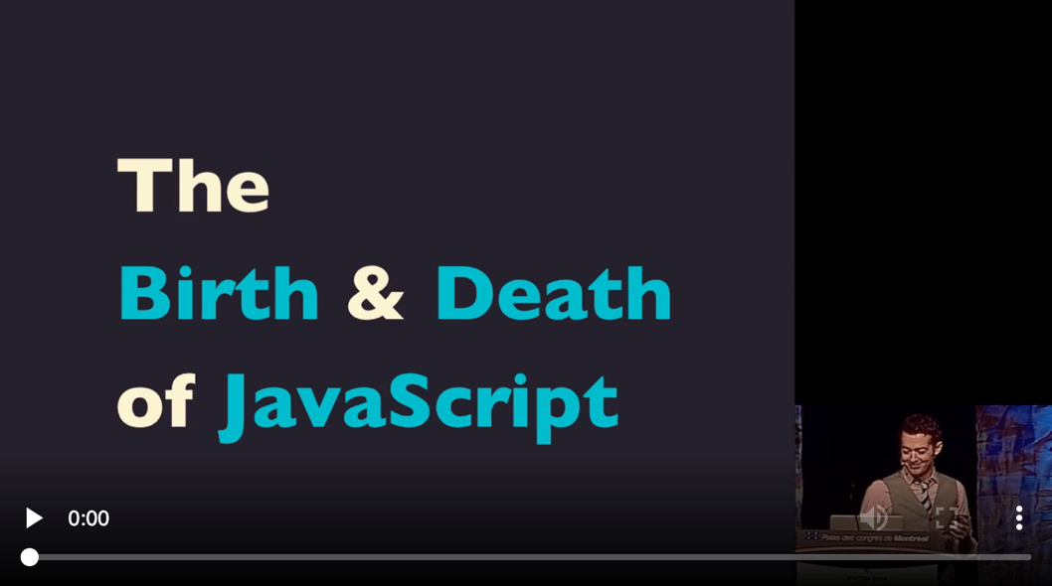
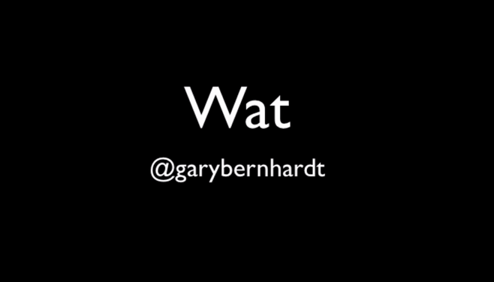
What About JavaScript?
https://www.destroyallsoftware.com/talks/wat
https://www.destroyallsoftware.com/talks/the-birth-and-death-of-javascript

Slide 39
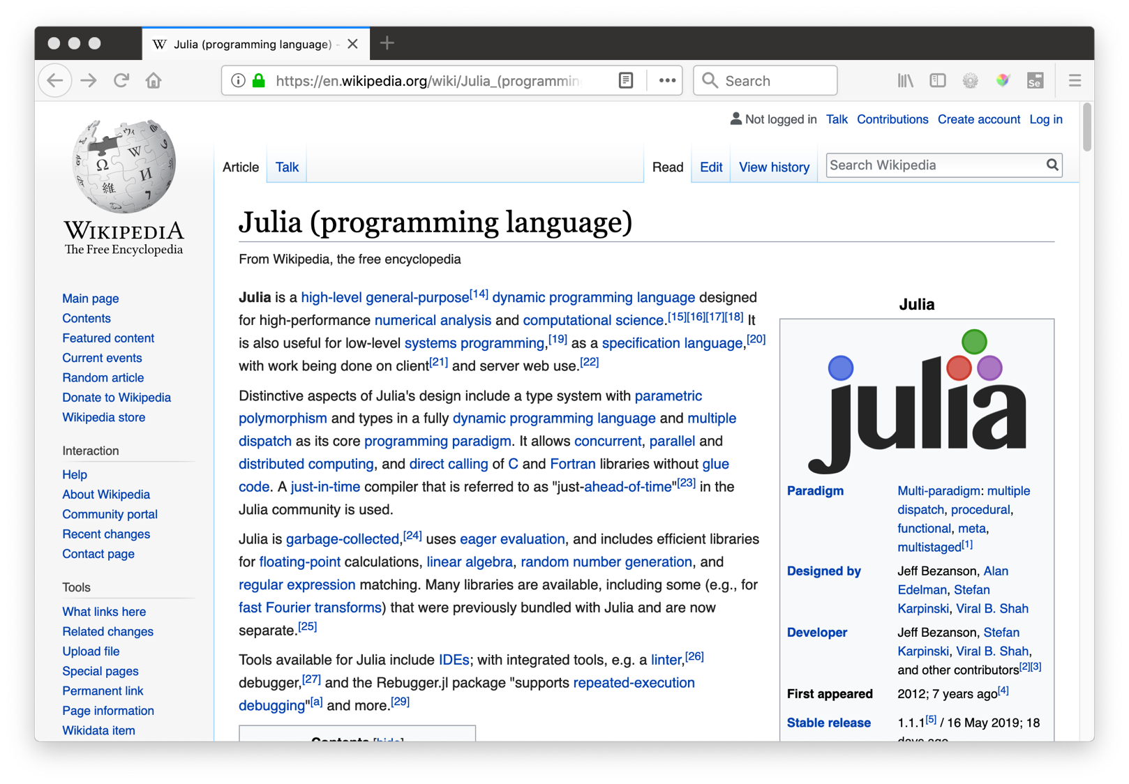

Slide 40
Python WAT

Slide 41
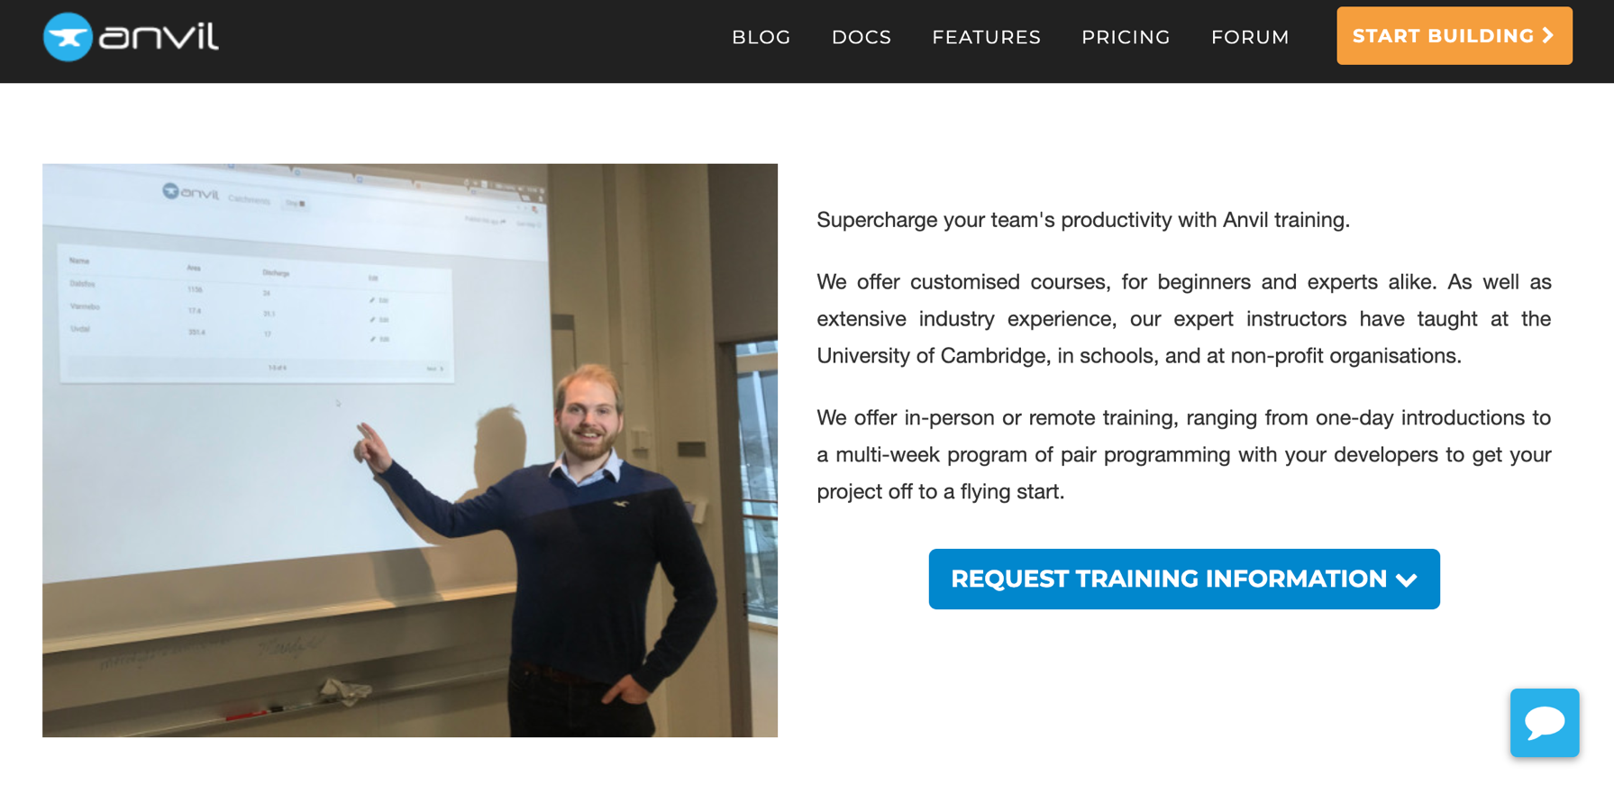

Slide 42
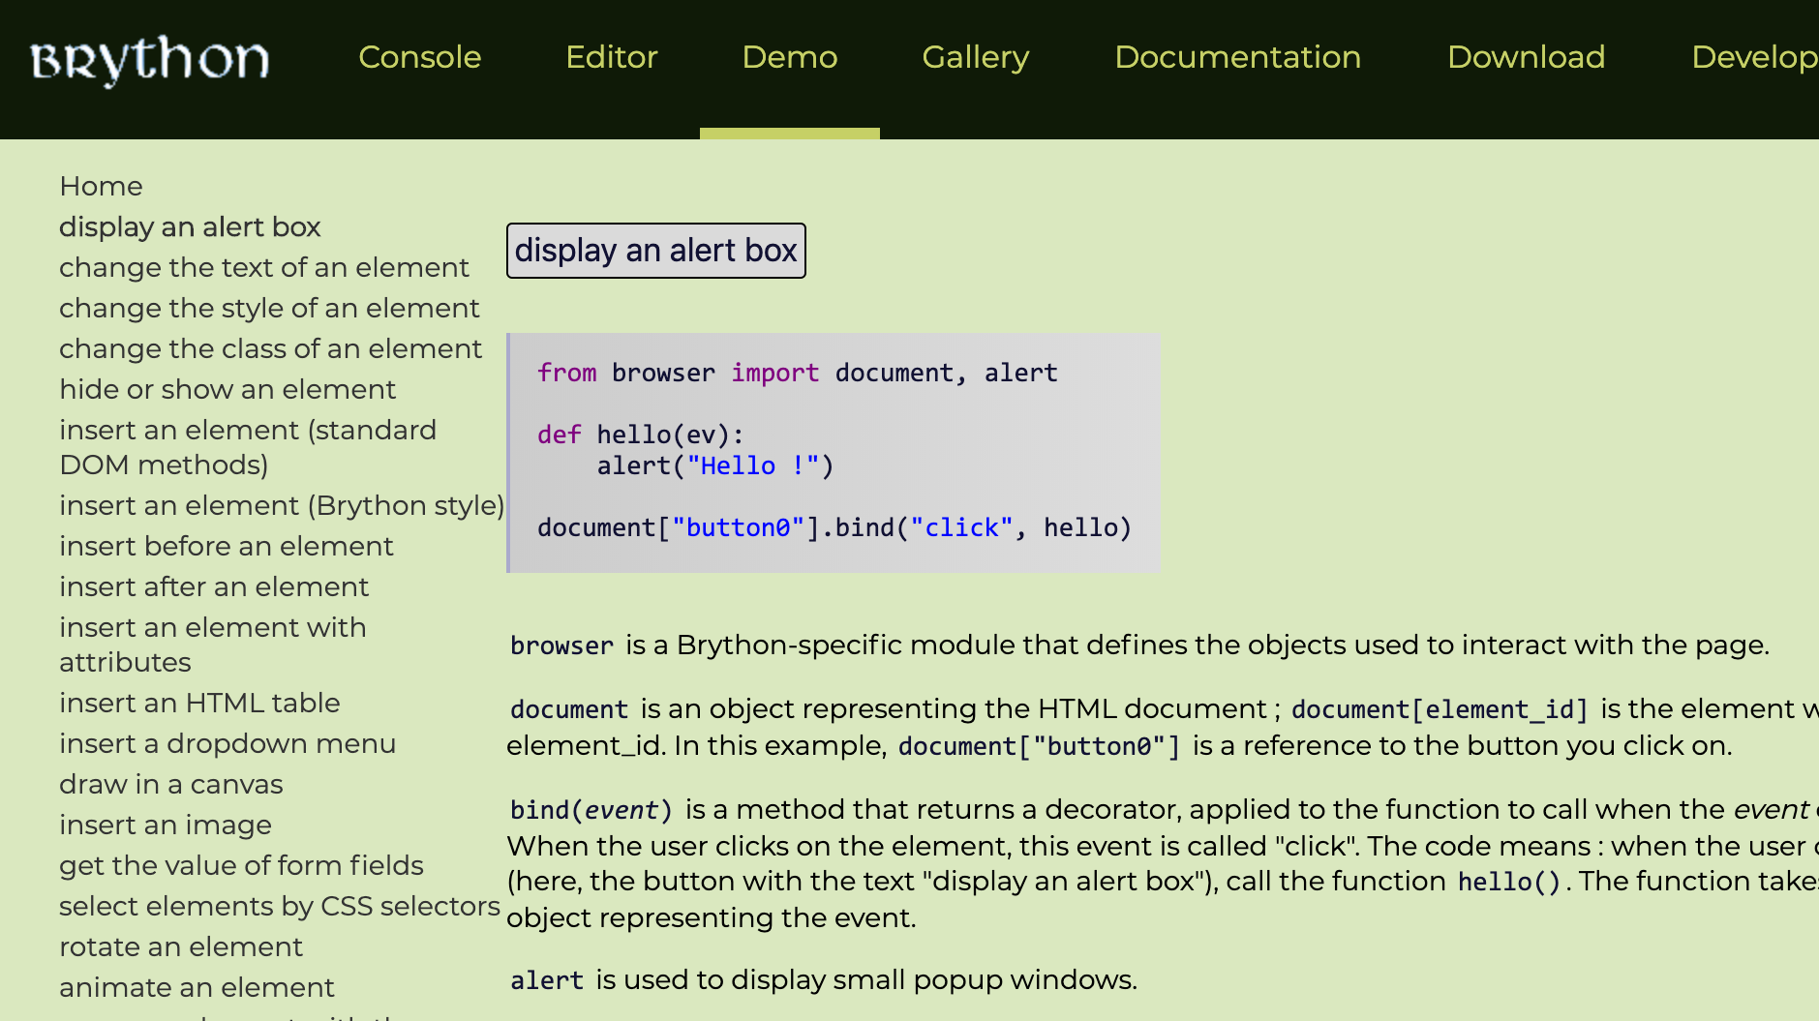

Slide 43
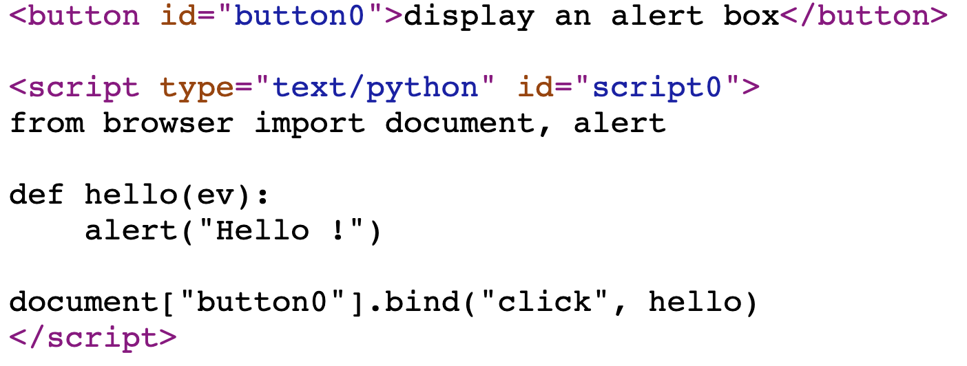

Slide 44
Presentation SWOT

Slide 45
What About Desktop / Mobile Apps?
Starting in 2015
HTML
CSS
JavaScript
Python
SQL
Django
Pandas
Numpy
React
VueJS
Swift
Java
VB.Net
iconic
asm.js
NLTK
SciPY
PyGame
C
TensorFlow

Slide 46
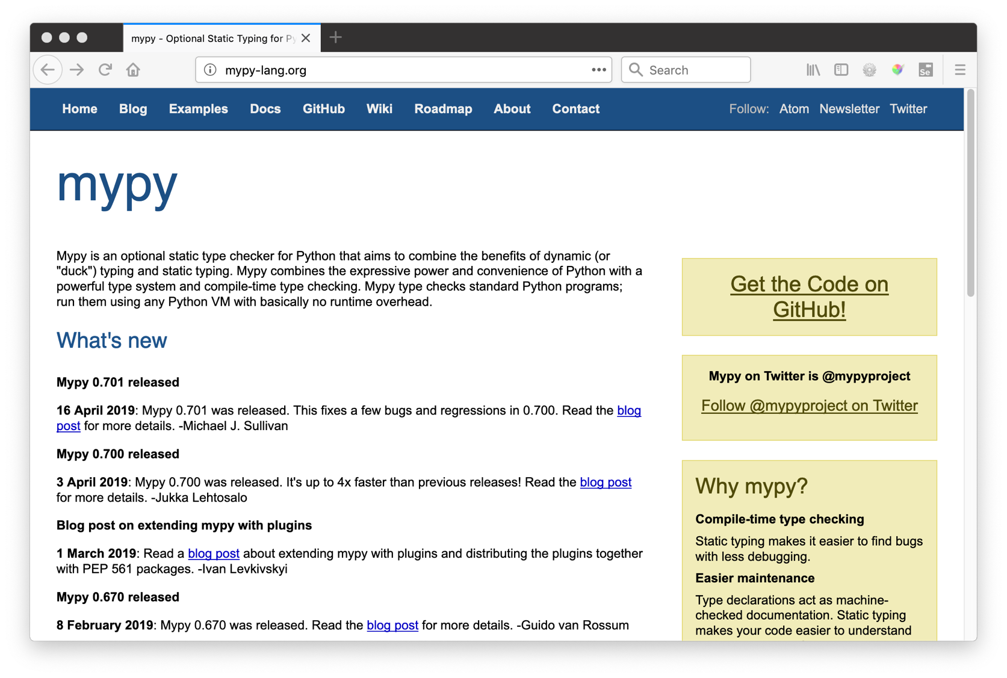

Slide 47

from django.shortcuts import render
from django.views import View
from django_tsugi.mixins import TsugiMixin
class GradeView(TsugiMixin, View):
def get(self, request) :
context = {'tsugi': request.tsugi}
return render(request, 'grade/main.html', context)
def post(self, request) :
grade = float(request.POST.get('grade'))
comment = request.POST.get('comment')
retval = request.tsugi.result.gradeSend(grade, comment)
context = {'tsugi': request.tsugi, 'retval' : retval}
return render(request, 'grade/done.html', context)

Slide 48

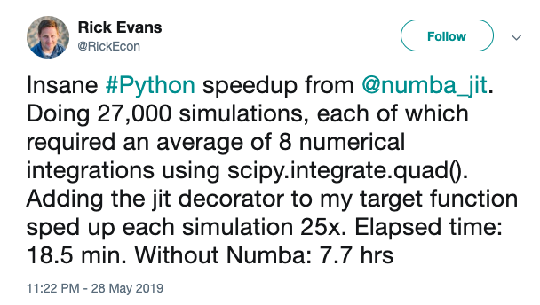

Slide 49
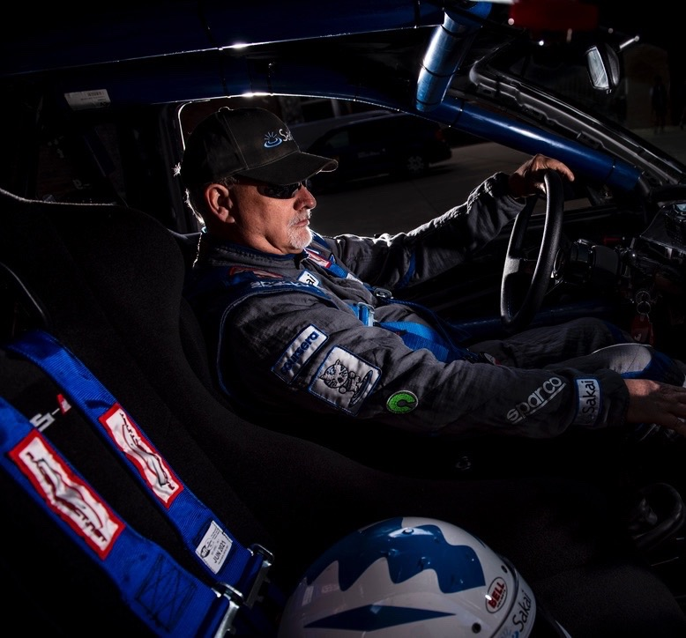
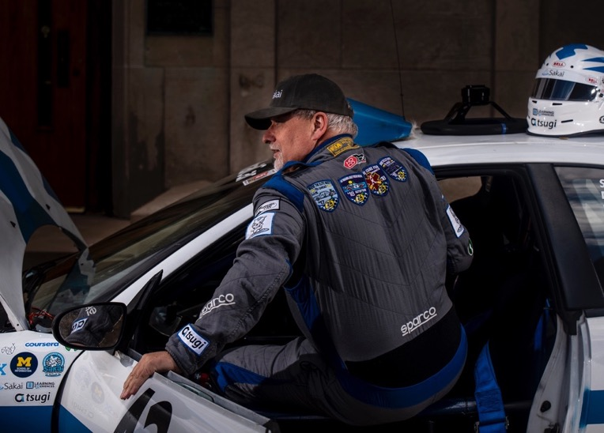
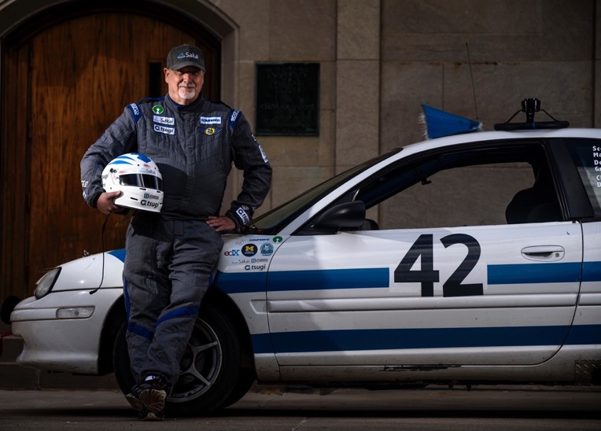
THANK YOU!
www.umsi.umich.edu
www.dr-chuck.com
www.py4e.com
www.tsugi.org
www.sakaiger.com/sakaicar

